Slide 1
Internetworking
Lecture 18
CT4005NI - Computer Hardware and Software
Architectures

Slide 2
Is it possible to communicate with someone living abroad?

Slide 3
The answer is YES!
Notes:
Give an example of how social media sites such as Facebook have helped people around the world communicate with each other.

Slide 4

Networks Affect Our Lives
Networks Connect Us
World without boundaries
Global communities
Human Network
Notes:
Communication is almost as important to us as our reliance on air, water, food, and shelter.
News events and discoveries are known worldwide in seconds.
Individuals can even connect and play games with friends separated by oceans and continents.

Slide 5
What do you use to communicate with a friend living abroad?

Slide 6
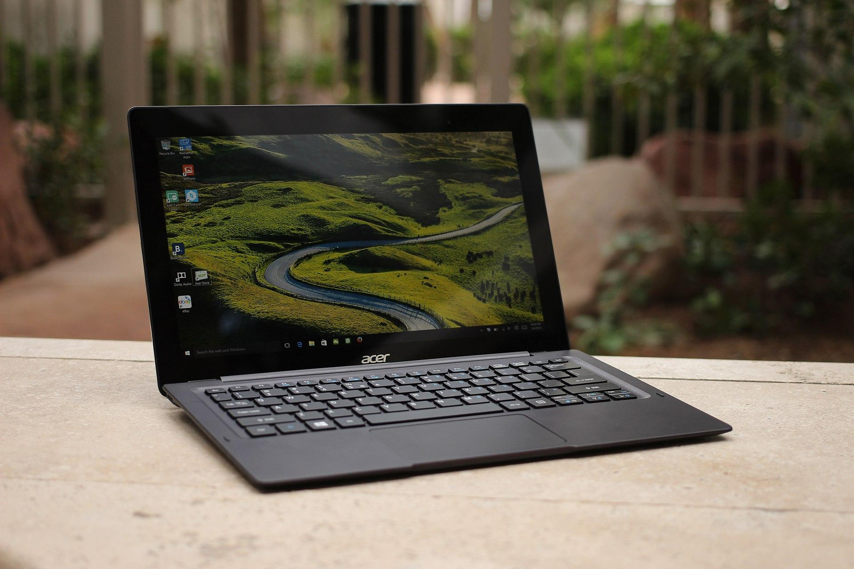
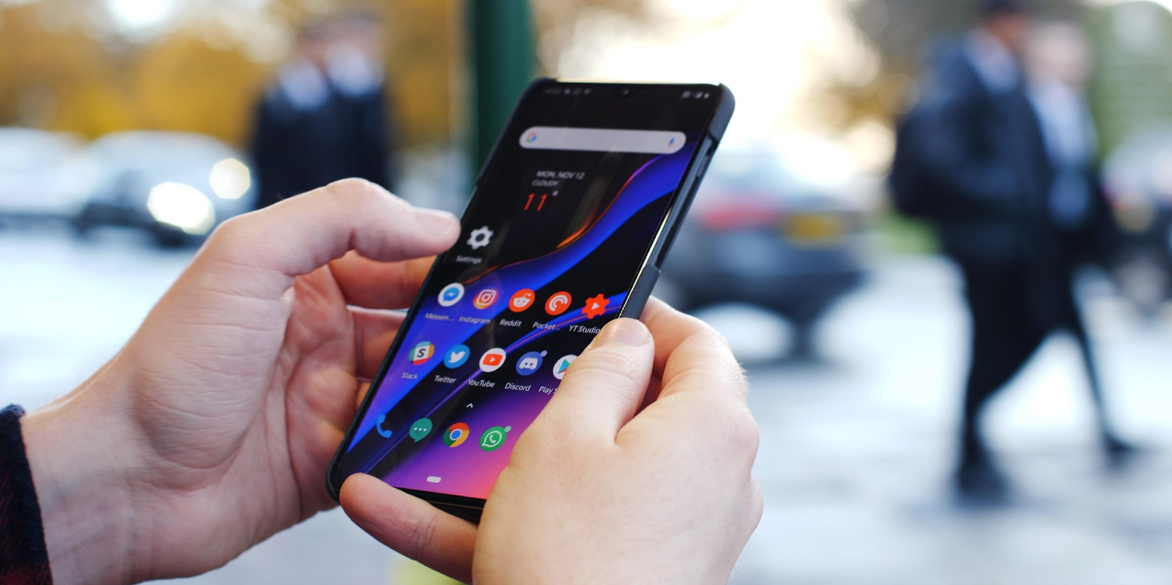
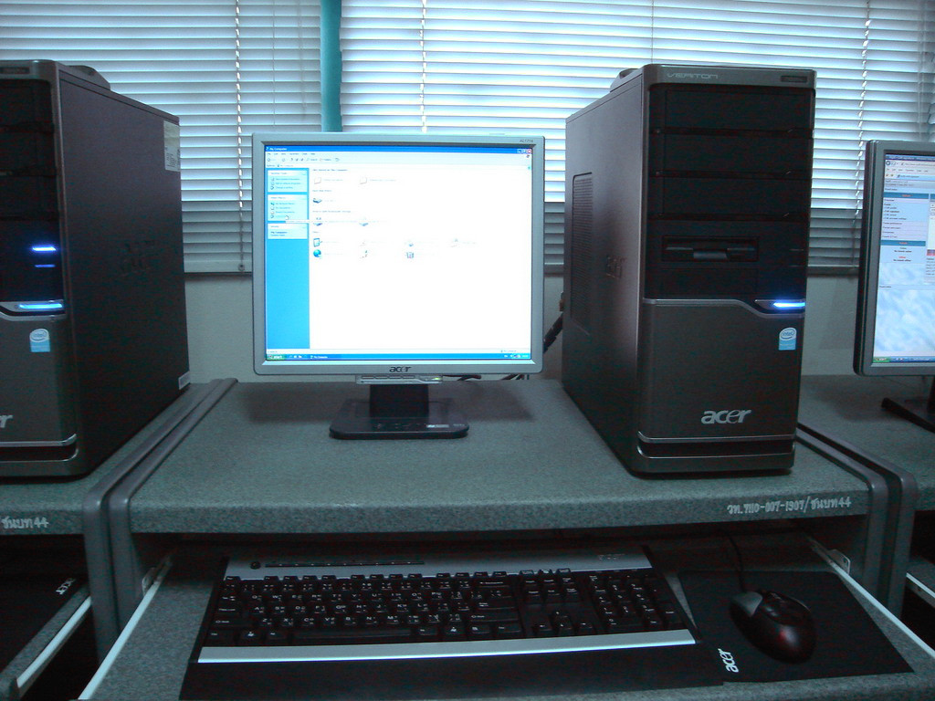
1. Laptop/ Mobile/ Computer
This Photo by Unknown Author is licensed under CC BY-SA
This Photo by Unknown Author is licensed under CC BY-SA
This Photo by Unknown Author is licensed under CC BY-SA

Slide 7
Network Components
Networking Today
Notes:
If you want to be a part of a global online community, your computer, tablet, or smart phone must first be connected to a network.
That network must be connected to the internet.
This topic discusses the parts of a network.

Slide 8
Network Components End Device
Every computer on a network is called a host or end device.
Data originates with an end device
Flows through the network
Arrives at an end device
This Photo by Unknown Author is licensed under CC BY-SA
This Photo by Unknown Author is licensed under CC BY-SA
This Photo by Unknown Author is licensed under CC BY-SA

Slide 9
Network Components Servers
Computers that provide information to end devices
Server Type | Description
Email | Email server runs email server software. Clients use client software to access email.
Web | Web server runs web server software. Clients use browser software to access web pages.
File | File server stores corporate and user files. The client devices access these files.

Slide 10
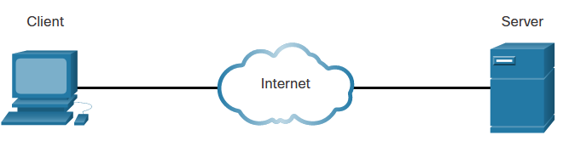
Network Components Clients
Send requests to the servers to retrieve information

Slide 11
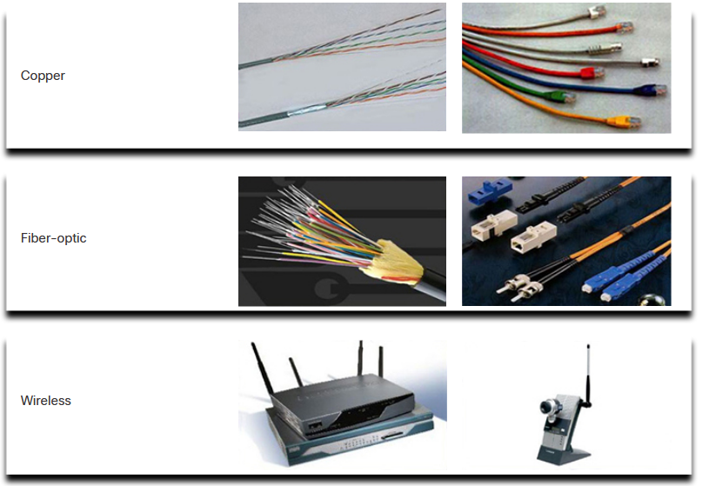
Network Components Network Media
Allows a message to travel from source to destination.
Media Types | Description
Metal wires within cables | Uses electrical impulses
Glass or plastic fibers within cables (fiber-optic cable) | Uses pulses of light.
Wireless transmission | Uses modulation of specific frequencies of electromagnetic waves.

Slide 12
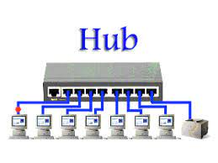
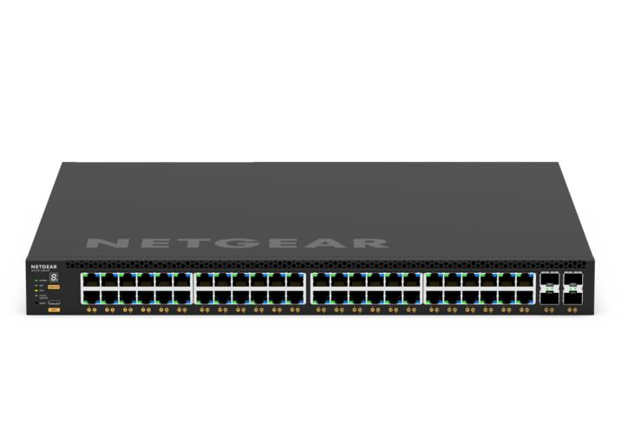
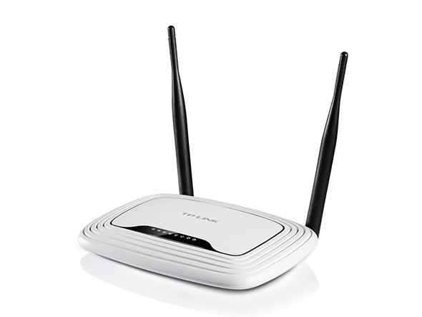
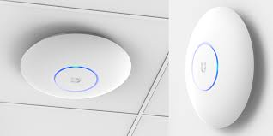
Network Components Intermediary Network Devices
Interconnects end devices

Slide 13
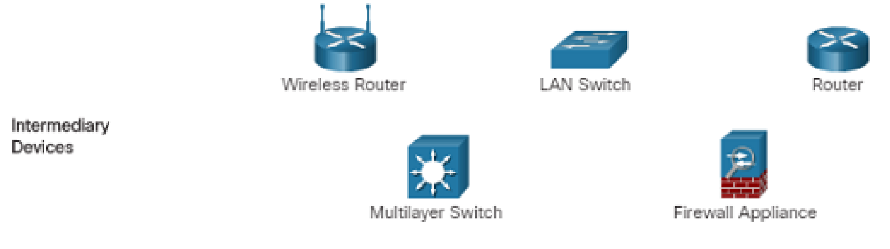
Network Components Intermediary Network Devices (Cont.)
Management of data as it flows through a network
Regenerate and retransmit data signals.
Maintain information about what pathways exist in the network.
Notify other devices of errors and communication failures.
Notes:
Level 4 – Basic Configurations of Router and LAN Switch
Level 5 – Basic Configurations of Multilayer Switch and Wireless Router
Level 6 – Basic Configurations of Firewall Appliance

Slide 14
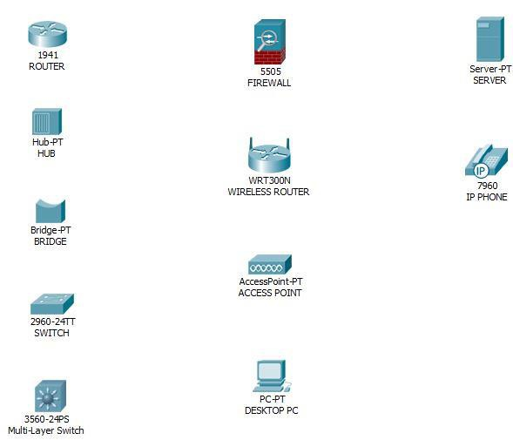
Components of a Computer Network

Slide 15
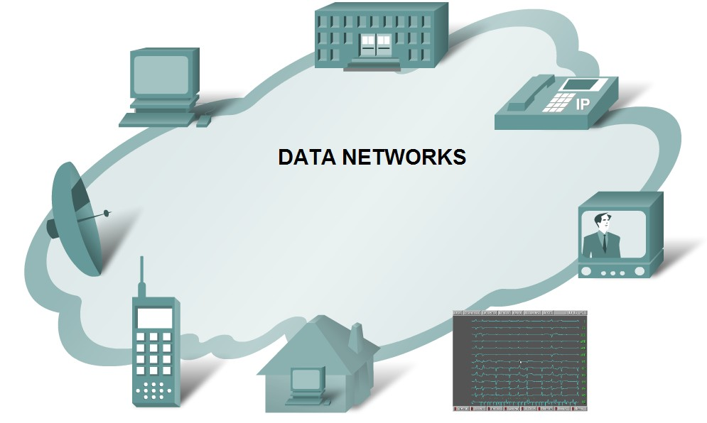
Basic Characteristics of Communication
Rules or agreements are established in the first step.
Information is molded into a format which can be transmitted in a data network.
Data may get delivered through different paths to the destination.

Slide 16
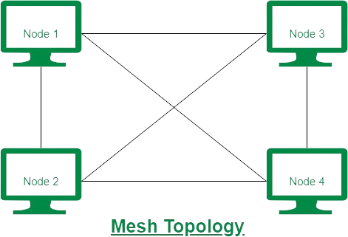
Mesh Topology
Mesh topology is which connects every computer
to another.
It requires a lot of wires and network
interfaces to connect to another device.
The number of connections required is
calculated as,
Connections= n(n-1)/2

Slide 17
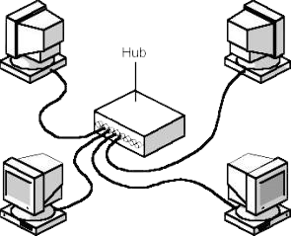
HUB (Networking device)
Due to many connections in mesh topology,
a new type of device was invented which made
devices to connect to central device.
It is layer 1 device
It is star topoplogy
This decreased the amount of wires
and network interfaces required.

Slide 18
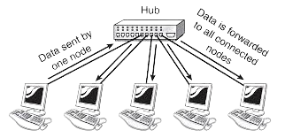
HUB (continue)
HUB works by receiving message in one port and sending the message in all other port (broadcast the message to all devices)
It got major issues,
1. Single collision domain
2. Limited bandwidth
3. Security risks

Slide 19
Collision Domain
A collision domain is a network segment in which collisions can occur.
Devices within the same collision domain share the same communication channel, such as a segment connected by a hub, where collisions are possible.

Slide 20
CSMA/CD
Ethernet is scalable which makes it easier to integrate new technologies.
Ethernet is a contention based media access method that allows all hosts on a network to share the same bandwidth of a link.
Ethernet uses CSMA/CD.
Carrier Sense Multiple Access with Collision Detection (CSMA/CD) is a protocol/algorithm, which helps devices share the bandwidth evenly without having two devices transmit data at the same time on the shared network
transmission medium.
CSMA/CD was created to overcome the problem of collisions

Slide 21
CSMA/CD
When a host wants to transmit over the network, it first checks for the presence of a digital signal on the wire.
If all is clear, the host will then proceed with its transmission.
The transmitting host constantly monitors the wire to make sure no other hosts begin transmitting.
If the host detects another signal on the wire, it sends out an extended jam signal that causes all nodes on the segment to stop sending data.
Back-off algorithms determines when the colliding stations can retransmit.
If collisions keep occurring after 15 tries, the nodes will time out.

Slide 22
End of Lecture 18

